Slide 1
Galaxy classification: a data science workflow with R Server 9
DA334
Hong Ooi
Senior Data Scientist, ADS Asia Pacific

Slide 2
Contents
Microsoft R Server
Machine learning with MicrosoftML
SQL operationalization with sqlrutils
Deployment with mrsdeploy
Team data science process
Putting it all together: classifying galaxies

Slide 3
Microsoft R Server

Slide 4

What is
Language
Platform
A statistics programming language
A data visualization tool
Open source
Community
2.5+M users
Taught in most universities
New and recent grads use it
Thriving user groups worldwide
Ecosystem
10000+ free packages on CRAN
Scalable to big data
Rich application & platform integration

Slide 5
Challenges posed by open source R
?
?
Limited Data Scale
Inadequate
Modeling Performance
Lack of Commercial Support
Complex Deployment
Processes

Slide 6
R from Microsoft brings
Peace of mind
Efficiency
Speed and scalability
Flexibility and agility

Slide 7
MicrosoftML

Slide 8
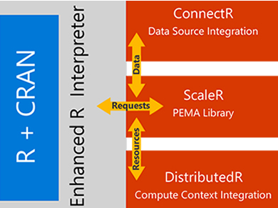

MicrosoftML = Scalable R + world class ML
Microsoft R Server
MicrosoftML Toolkit
Enterprise-grade
Supported
Secure
Deployable
Scalable/Distributed
Portable
Fast, Scalable Learners
Battle-tested
State of the art
+

Slide 9


Vision: be the best machine learning R package
Simpler
Auto-featurization
Auto-tuning
Consistent interfaces
Easy operationalization
Better
State-of-the-art accuracy
Detailed feedback
Scalable by rows or cols
1
🏆
2
3
Faster
Fast featurization
Fast training
Fast prediction
Multi-core
Integrated
Cross-platform
On-prem/cloud
In SQL
MRS
🏃

Slide 10
Key differentiators
Fast and accurate
Text classification
Beat xgBoost and H20 on most real-world data sets in speed and accuracy
Classification, Regression, Anomaly detection
Fast, easy, and scalable
Uses tech from Bing, Office, and TLC
Sentiment analysis, Support ticket classification
DNNs with GPU acceleration
High-dimensional data
DNNs with custom topology and GPU acceleration
Retail image matching, Medical image classification
Handle billion features
Text, Click-through prediction, problems with many userIDs, productIDs, etc.

Slide 11
Initial feature set (more to come)
Algorithm | Strengths
rxFastLinear | Fast linear regression with L1 and L2 regularization
rxLogisticRegression | Logistic regression with L1 and L2 regularization
rxFastTree | Boosted decision tree from Bing, competitive with XGBoost
rxFastForest | Random forest
rxNeuralNet | GPU-accelerated neural nets, complex architectures supported with Net# language
rxOneClassSvm | Anomaly detection or unbalanced binary classification

Slide 12
SQL Server R Services

Slide 13




Introducing SQL Server 2016 R Services
Simplicity and agility
Scalability and choice
Cost effectiveness
Enterprise speed and performance
Near-DB analytics
Parallel threading and processing
Model on-premises, store in cloud—or vice versa
Hybrid memory and disk scalability
Not bound by memory-enabling limits of larger datasets
Included in SQL Server 2016
Reuse and optimize existing R code
Eliminate data movement across machines
Write once, deploy anywhere

Slide 14
SQL Server Enterprise Edition R Services
SQL Server 2016 Enterprise Edition
SQL Server R Services
Integration Facilities:
Component Integration
Launchers
Parameter Passing
Results Return
Console Output Return
Parallel Data Exchange (RTM)
Stored Procedures
Package Administration
Microsoft R Open
Open Source R Interpreter
100% Open Source R
Fully CRAN Compatible
Accelerated Math
SQL Server
Query Processor
Algorithm Library
Fast, Parallel, Storage Efficient Algorithms
Data Prep
Descriptive Stats
Sampling
Statistical Tests
Predictive Models
Variable Selection
Clustering
Classification
Custom APIs for R + CRAN
Parallel Scoring

Slide 15
Scalable in-database analytics
How is it Integrated?
T-SQL calls a Stored Procedure
Script is run in SQL through extensibility model
Result sets sent through Web API to database or applications
Extensibility
Example Solutions
Fraud detection
Sales forecasting
Warehouse efficiency
Predictive maintenance
R Integration
R
?
Data Scientist
Interacts directly with data
Creates models and experiments
Benefits
Faster deployment of ML models
Less data movement, faster insights
Work with large datasets: mitigate R memory and scalability limitations
Analytic Library
010010
100100
010101
T-SQL Interface open source/Microsoft R
Data Analyst/DBA
Relational Data
Manages data and
analytics together

Slide 16
R Server operationalisation

Slide 17


Operationalising advanced analytics
Instant Deployment
Deploy to Anywhere
Fast and Scalable
Secure and Reliable
Turn R analytics → Web services in one line of code;
Swagger-based REST APIs, easy to consume, with any programming languages, including R!
Deploying web service server to any platform: Windows, SQL, Linux/Hadoop
On-prem or in cloud
Fast scoring, real time and batch
Scaling to a grid for powerful computing with load balancing
Diagnostic and capacity evaluation tools
Enterprise authentication: AD/LDAP or AAD
Secure connection: HTTPS with SSL/TLS 1.2
Enterprise grade high availability

Slide 18


Best-in-class deployment experience
Easy Consumption
Explore and consume services in R directly
Data Scientist
Easy Deployment
Turn R into web services in one line of code
Microsoft R Client
(mrsdeploy package)
Data Scientist
Services / Sessions
getService
Microsoft R Client
(mrsdeploy package)
publishService
Microsoft R Server
configured for
operationalizing R analytics
REST API calls
Developer
Easy Integration
Swagger-based APIs: easy to consume with any programming language
Easy Setup
In-cloud or on-prem
Adding nodes to scale
High availability & load balancing
Remote execution server
Apps

Slide 19

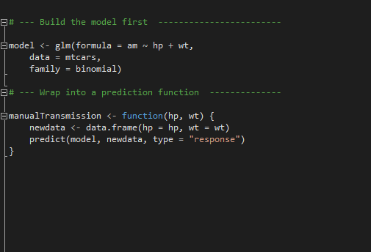
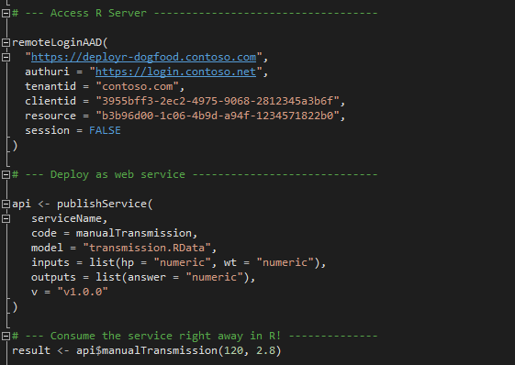
Easy deployment
Build the model first
Deploy as a web service instantly

Slide 20
Shiny vs R Server deployment
Shiny Apps
R Server Apps
Sharing analysis result
via interactive web apps
Integrating R with LOB apps
with any programming language
Data Scientist
Developer
Scenario:
Share my analysis via an interactive web app
Scenario:
Integrate Lead Scoring in CRM system

Slide 21
Team data science process

Slide 22
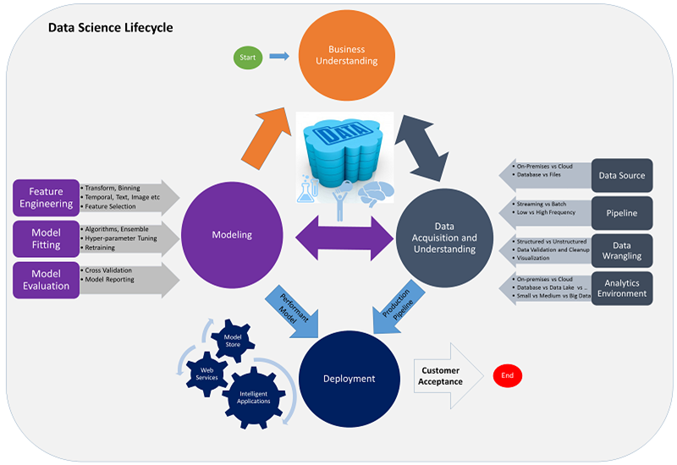
Team data science process

Slide 23
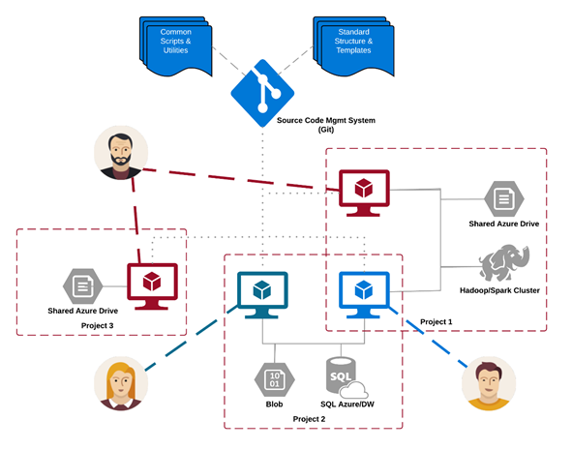
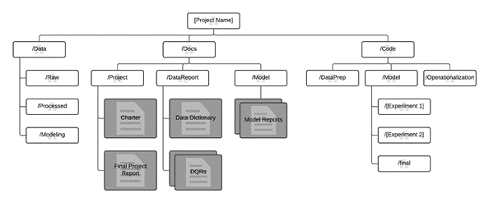
Standard project structure + repo
More information: https://github.com/Azure/Microsoft-TDSP

Slide 24
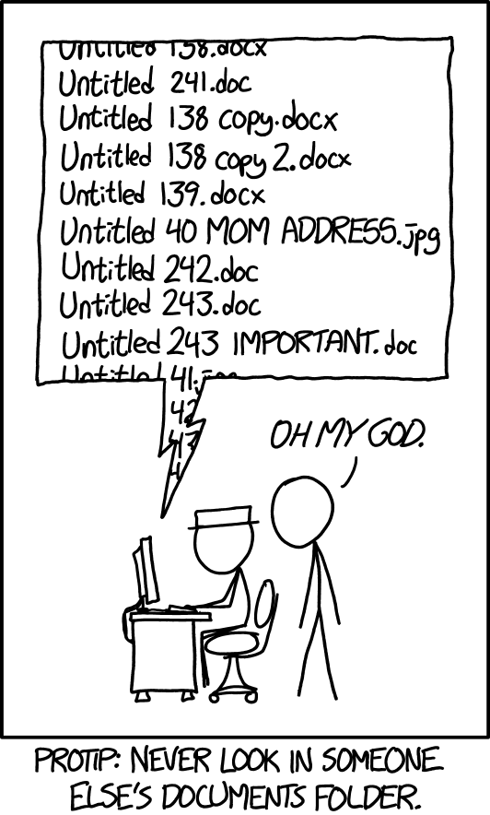
Source: Xkcd “Documents”, https://xkcd.com/1459/

Slide 25

Source: Xkcd “Git”, https://xkcd.com/1597/

Slide 26
Galaxy classification

Slide 27
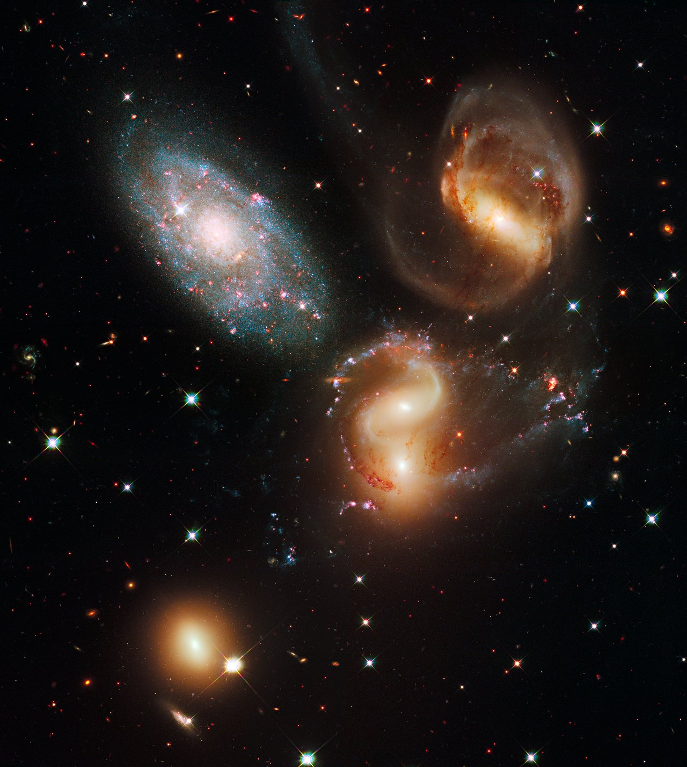
Classifying galaxy structure with DNNs
Based on a talk by Andrie de Vries, Data Science Lead, ADS London at MLADS last year
@RevoAndrie
adevries@microsoft.com
All images obtained from Hubble Space Telescope site unless otherwise noted: http://www.spacetelescope.org
Galactic wreckage in Stephan’s Quintet

Slide 28
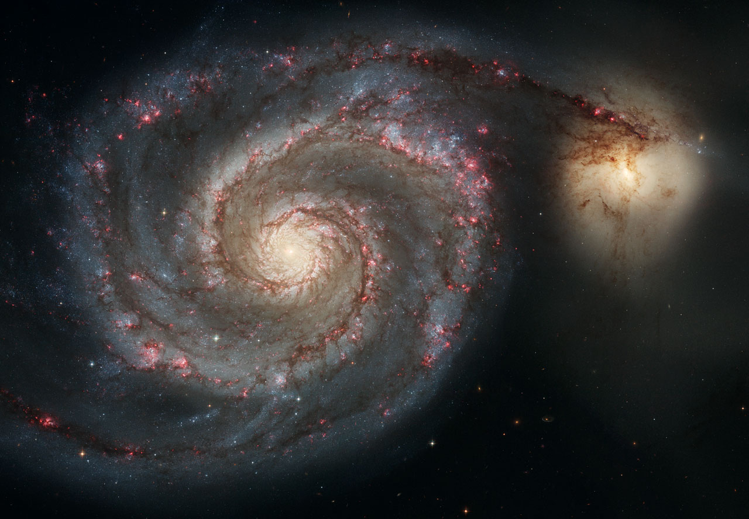
Whirlpool Galaxy (M51) and companion galaxy

Slide 29

“Grand design” spiral galaxy M81

Slide 30
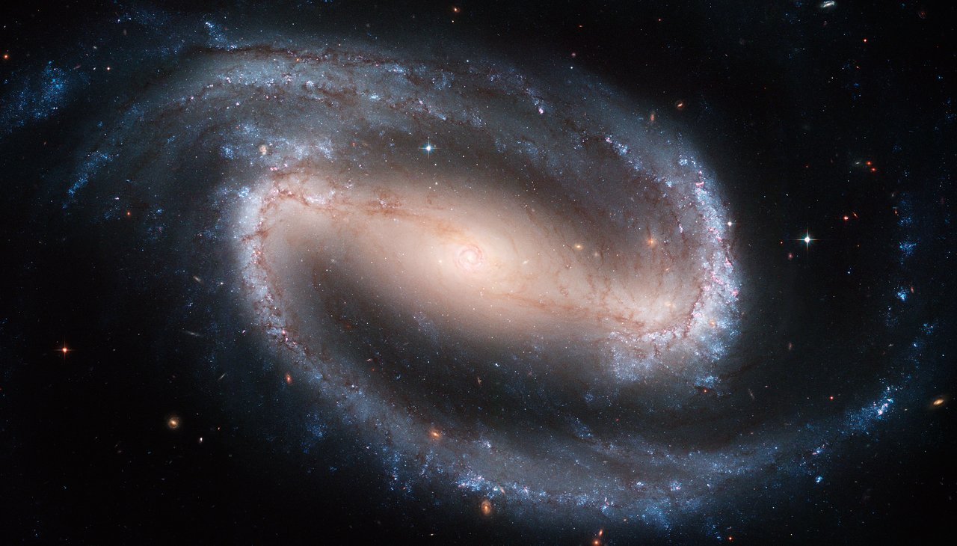
Barred spiral galaxy NGC 1300

Slide 31
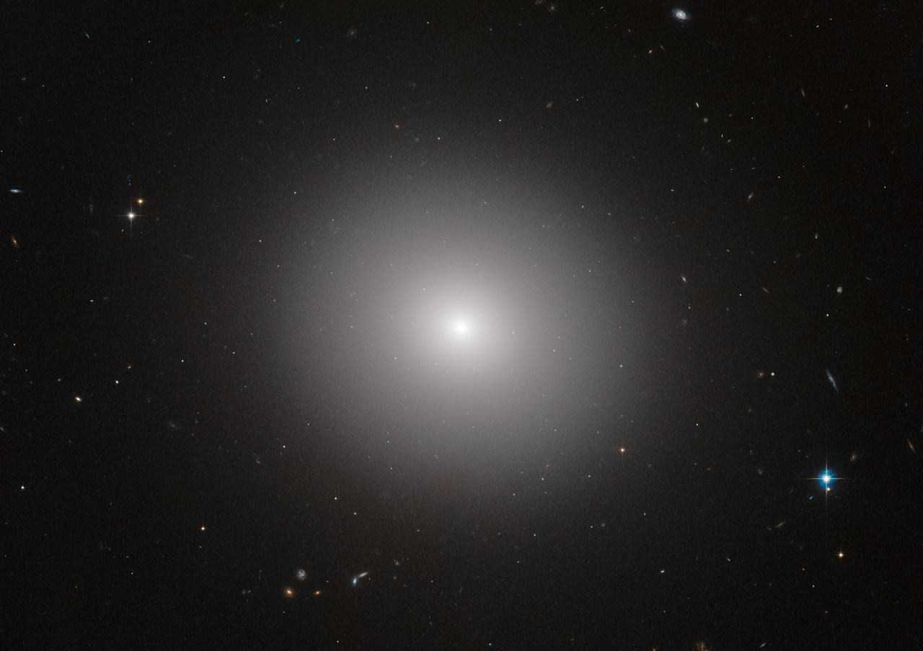
Elliptical galaxy IC 2006

Slide 32
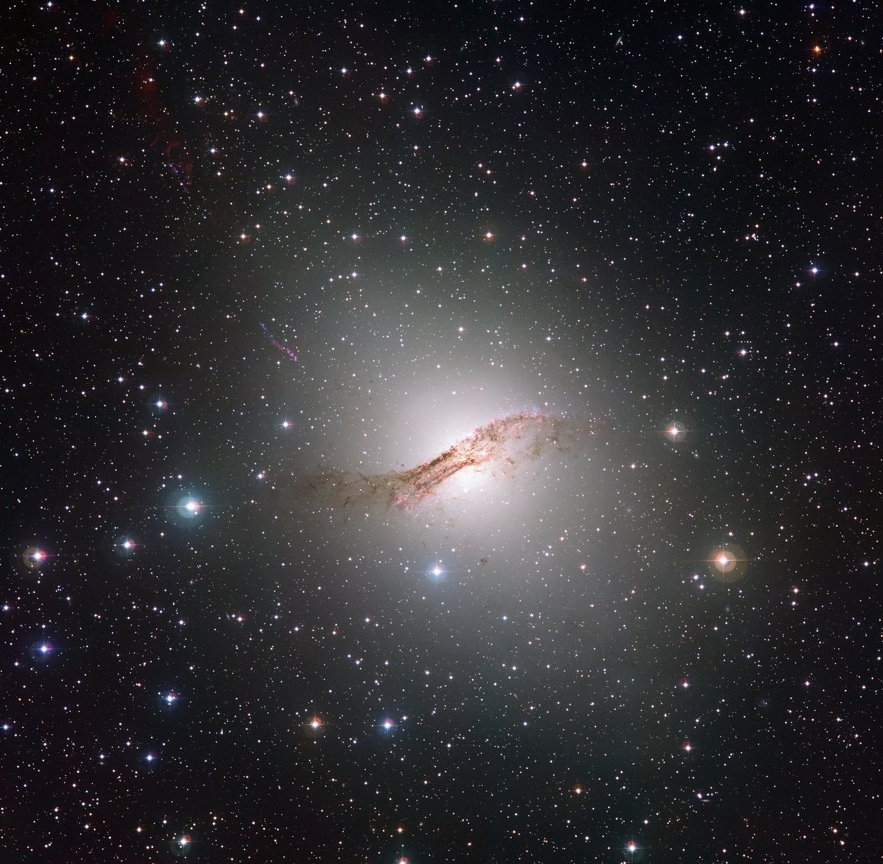
Centaurus A, from European Southern Observatory: http://www.eso.org

Slide 33
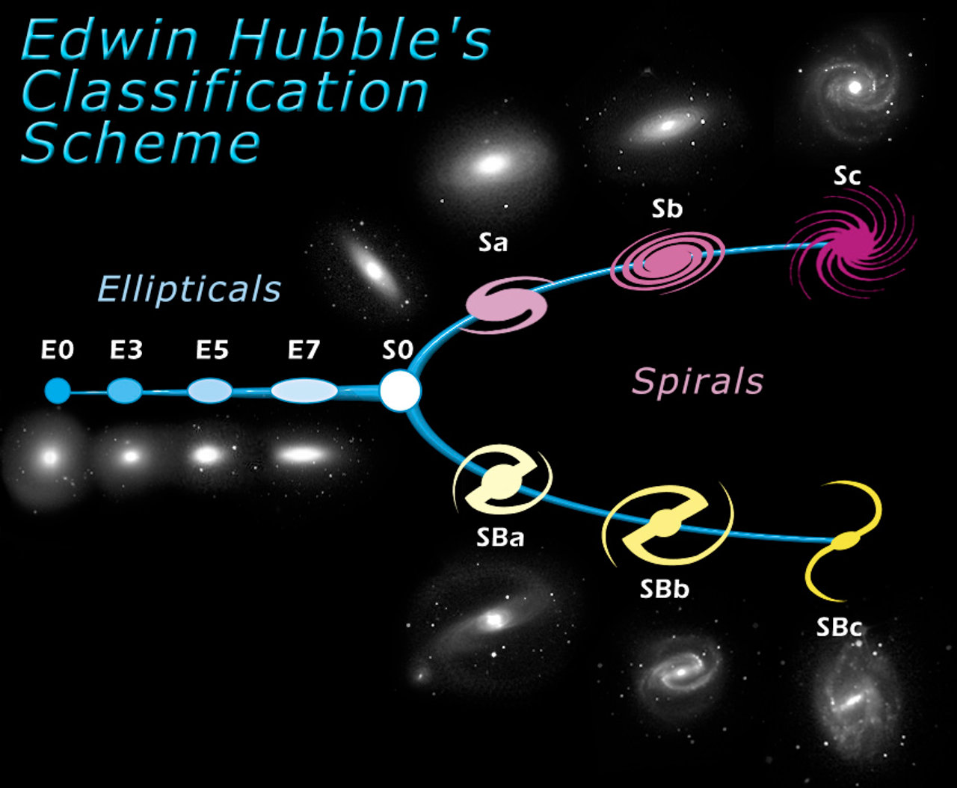
The “Hubble tuning fork”
Source: Wikipedia

Slide 34
The data deluge
The Sloan Digital Sky Survey has imaged ~900,000 galaxies
Too many for professional astronomers to classify
https://demosgallery.azurewebsites.net/#story/galaxy
https://blogs.technet.microsoft.com/dataplatforminsider/2016/03/10/mapping-the-universe-with-sql-server/

Slide 35
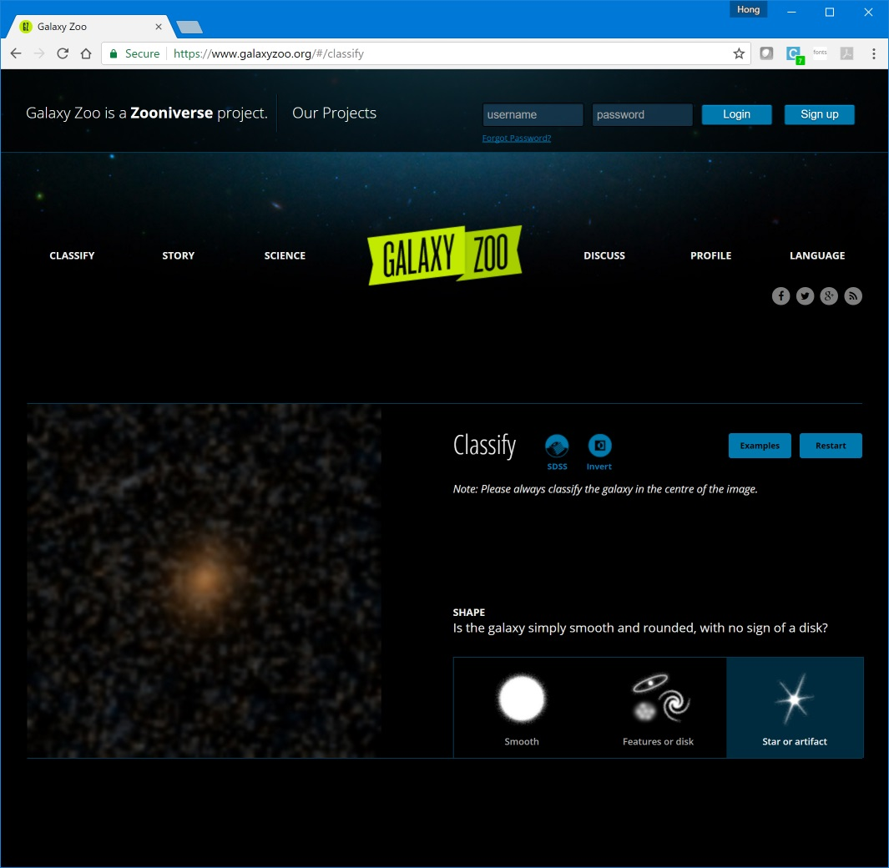
The Galaxy Zoo
Source: Willett et al, “Galaxy Zoo 2: detailed morphological classifications for 304,122 galaxies from the Sloan Digital Sky Survey”, https://arxiv.org/abs/1308.3496

Slide 36


How to classify?
Professionals
Citizen data scientists
Computer vision?
Johannes Vermeer, The Astronomer

Slide 37

Deep learning for image recognition
Source: http://cs231n.github.io/convolutional-networks/

Slide 38
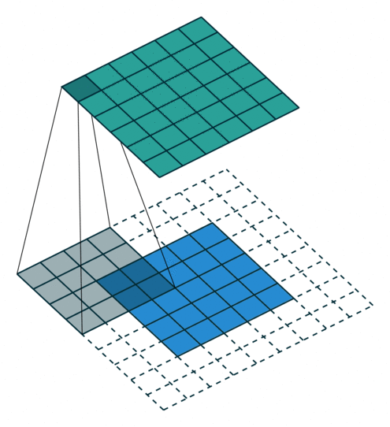


Network anatomy
Convolution + ReLU: find the pattern
Pooling: collapse it down
Fully connected layer(s): choose a label
Sources: https://github.com/vdumoulin/conv_arithmetic (left), http://cs231n.github.io/convolutional-networks/

Slide 39
Results
Training data
Test data
 | Ambiguous | Barred Spiral | Spiral | Elliptical
Ambiguous | 158 | 2 | 33 | 44
Barred Spiral | 0 | 16959 | 7740 | 1707
Spiral | 9 | 3100 | 128064 | 14648
Elliptical | 9 | 617 | 10210 | 116700
 | Ambiguous | Barred Spiral | Spiral | Elliptical
Ambiguous | 6 | 0 | 6 | 18
Barred Spiral | 1 | 1177 | 1201 | 306
Spiral | 7 | 662 | 11430 | 2397
Elliptical | 10 | 162 | 1992 | 10625
Error rate = 12.7%
Error rate = 22.5%

Slide 40
Workflow outline
Download catalog
Download individual image files
Fit (and refit) model
Export model to SQL
Deploy
Frontend

Slide 41
Model fitting
input pixels [3, 50, 50];
hidden conv1 [64, 23, 23] rlinear from pixels convolve {
InputShape = [3, 50, 50];
KernelShape = [3, 6, 6];
Stride = [1, 2, 2];
Sharing = [false, true, true];
MapCount = 64;
}
hidden norm1 [64, 23, 23] from conv1 response norm {
InputShape = [64, 23, 23];
KernelShape = [1, 1, 1];
Alpha = 1e-04;
Beta = 0.75;
Offset = 1;
AvgOverFullKernel = true;
}
...
Read images directly from disk
library(MicrosoftML)
model <- rxNeuralNet(class2 ~ pixels,
data=trainData,
type="multiClass", mlTransformVars="path",
mlTransforms=list(
"BitmapLoaderTransform{col=Image:path}",
"BitmapScalerTransform{col=bitmap:Image width=50 height=50}",
"PixelExtractorTransform{col=pixels:bitmap}"
),
netDefinition=netDefinition,
optimizer=sgd(),
acceleration="gpu",
miniBatchSize=256,
numIterations=100,
normalize="no", initWtsDiameter=0.1, postTransformCache="Disk"
)
GPU (CUDA) accelerated

Slide 42
Export model to SQL
library(RevoScaleR)
galaxyModTable <- RxSqlServerData("galaxyModels", connectionString=deployDbConnStr)
initObjectTable("galaxyModels", versionName=NULL, connectionString=deployDbConnStr)
writeGalaxyModel <- function(model, name, table=galaxyModTable)
{
if(missing(name))
name <- deparse(substitute(model))
rxWriteObject(table, name, model)
}
writeGalaxyModel(model)
Serialise any R object to a database table

Slide 43
Prediction function (simplified)
spBasePredictGalaxyClass <- function(model, imgData)
{
# for each image, preprocess the file and store it
path <- sapply(seq_len(nrow(imgData)), function(i) {
inFile <- tempfile(fileext=".jpg")
outFile <- tempfile(fileext=".jpg")
writeBin(imgData$img[[i]], inFile)
imager::load.image(inFile) %>%
cropGalaxy(0.26) %>%
resizeGalaxy(c(50, 50)) %>%
imager::save.image(outFile)
outFile
})
imgData <- data.frame(galclass=" ", path=path)
model <- rxReadObject(as.raw(model))
rxPredict(model, imgData)
}
Use open source imager package for image processing
Unserialise R object previously saved to database

Slide 44
Export code to SQL
Generate T-SQL code to create a stored procedure
library(sqlrutils)
spPredictGalaxyClass <- StoredProcedure(spBasePredictGalaxyClass,
spName="predictGalaxyClass",
InputData("imgData",
defaultQuery="select * from galaxyImgData"),
InputParameter("model", "raw",
defaultQuery="select value from galaxyModels where id='model'"),
connectionString=deployDbConnStr
)
registerStoredProcedure(spPredictGalaxyClass, deployDbConnStr)
Execute the generated code

Slide 45
Deploy code to call SQL
Login to the remote R server
library(mrsdeploy)
remoteLogin("https://example.com:12800")
apiPredictGalaxyClass <- function(id, img)
{
imgData <- data.frame(specobjid=id, img=img, stringsAsFactors=FALSE)
sqlImgData <- RxSqlServerData("galaxyImgData")
rxDataStep(imgData, sqlImgData, overwrite=TRUE)
sqlrutils::executeStoredProcedure(spPredictGalaxyClass)$data
}
apiGalaxyModel <- publishService("apiPredictGalaxyClass", apiPredictGalaxyClass, spPredictGalaxyClass,
inputs=list(id="character", img="character"),
outputs=list(pred="data.frame"))
cat(apiGalaxyModel$swagger(), file="swagPredictGalaxyClass.json")
remoteLogout()
Call the stored proc created earlier
Create a web service with defined inputs and outputs
Generate Swagger JSON to represent API

Slide 46
Demo

Slide 47
Packages used
RevoScaleR
MicrosoftML
sqlrutils
mrsdeploy
(RTVS)
(autorest)
dplyr (+magrittr)
imager
shiny
RODBC

Slide 48
Links
Microsoft R Server: https://www.microsoft.com/en-au/cloud-platform/r-server
Team Data Science Process: https://github.com/Azure/Microsoft-TDSP
Sloan Digital Sky Survey:
http://www.sdss.org/
https://www.galaxyzoo.org/
https://demosgallery.azurewebsites.net/#story/galaxy
https://blogs.technet.microsoft.com/dataplatforminsider/2016/03/10/mapping-the-universe-with-sql-server/

Slide 49
Continue your Ignite learning path
Visit Channel 9 to access a wide range of Microsoft training and event recordings https://channel9.msdn.com/
Head to the TechNet Eval Centre to download trials of the latest Microsoft products http://Microsoft.com/en-us/evalcenter/
Visit Microsoft Virtual Academy for free online training visit https://www.microsoftvirtualacademy.com
Notes:
The purpose of this slide is to ensure delegates consider their next steps after your presentation.
Option to use this slide in the current generic format or for you to recommend 1 (or more) Microsoft Virtual Academy Course or Channel 9 video that is relevant next steps from your presentation.
Thanks

Slide 50


Win a Spark After Dark drone pilot pass by completing your session evaluation ASAP #MSAUIGNITE

Slide 51
Remember to collect your wristbands for Spark After Dark! Located at Ignite Help Desk, Foyer C, Foyers Halls ¾ #MSAUIGNITE

Slide 52
Thank you Chat with me in the Speaker Lounge Contact me: hongooi@microsoft.com

